Slide 1

A Multi-Chain Model for CBDC
-paper review (10page)-
Wei-Tek Tsai^{1,2,3,4,5}, Zihao Zhao¹, Chi Zhang¹, Lian Yu^{2,3,5,6}, Enyan Deng²
1 Digital Society & Blockchain Laboratory, Beihang University, Beijing, P. R. China
2 Beijing Tiande Technologies, Beijing, China.
3 IOB Laboratory, National Big Data Comprehensive Experimental Area, Guizhou, China
4 Arizona State University, Tempe, AZ 85287, USA
5 School of Software and Microelectronics,Peking University, Beijing, China
6 Andrew International Sandbox Institute, Qingdao, China
2018 5th International Conference on Dependable Systems and Their Applications (DSA)
Citation : 9, IF : 2.450
한정수

Slide 2
Introduction
CBDC based on Blockchain
Immutability
Traceability
Transparency
Primary reason of CBDC
trades efficiently, reduces the costs and increases transparency
It instills confidence in the market, and will be an effective way for central banks to regulate the financial market
CBDC may not be under the direct regulation of the central bank, and CBDC can be used as a means to regulate them
Payment between banks are guaranteed by government
Notes:
모바일 디바이스가 발전함에 따라 connectivity의 중요성 증대
Mobile 기기들이 방대한 connectivity와 bandwidth를 제공
하지만 packet routing 비용이 비싸다(배터리 소모 등)
인센티브를 줘서 그 디바이스들의 idle 리소스를 활용하자

Slide 3
Introduction
New type of CBDC model
ABC : Account BC
TBC : Trading BC
Scalable and Mangable
Panda model for testing
Notes:
Intermittent 간헐적인
제안 모델 : R2P2
NDN 프로토콜을 사용
이는 mobility 환경에서 우수한 성능, 기존 host-centric 방식은 host 주소 배정문제와 요즘 호스트를 신경쓰지 않는 모바일의 트랜드 와 맞지 않음

Slide 4
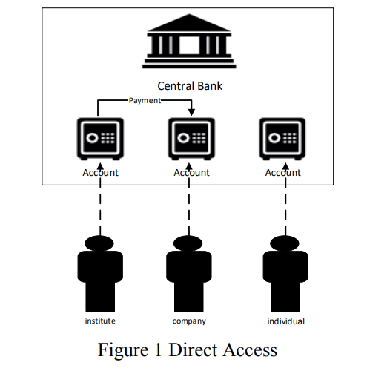
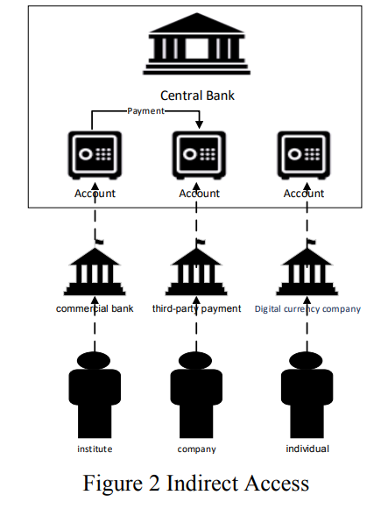
Background
Direct Access vs Indirect Access
Notes:
ad-hoc : 외부의 도움없이 자기들만으로 자율적인 임시 네트워크 망을 구성하는 것
NDN은 Interest와 Data 두가지 타입의 패킷을 갖고있으며 이들은 URI라고도 불림.
데이터 소비자가 interest packet을 데이터 컨텐츠 fetch를 위해 보내면 data produce가 해당 데이터와 연관된 컨텐츠 세그먼트를 데이터 패킷에 담아 다시 보냄
이 방식으로 컨텐츠가 어떤 호스트에 묶여있지 않음
이런 address-less한 라우팅은 소비자와 해당 경로에서 데이터를 소유한 어떠한 노드 간에 데이터 전달이 가능하게함
이는 ad-hoc network와 모바일 환경에서 유효함
데이터를 ad-hoc에 분산시켜 놓았다면 original producer의 데이터가 사라져도 컨텐츠를 가져오는 것이 가능해짐.
Upstream : interest forwarding toward contents
Downstream : data forwarding towards consumers

Slide 5
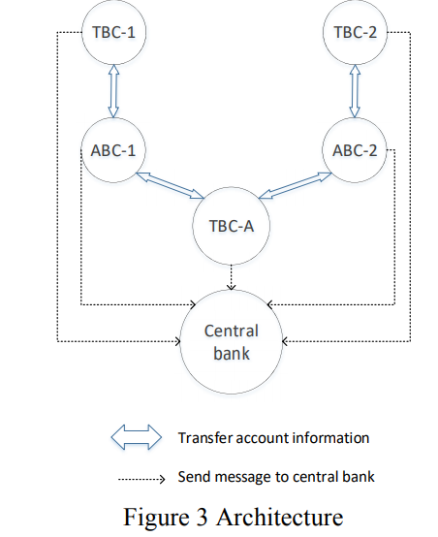
Panda Model
Architecture
ABC-1 maintains Bank-1’s accounts
TBC-1 processes transaction in ABC-1
TBC-A
Transactions between ABC-1 and ABC-2
Regulatory technology
Detect illegal transaction with KYC, AML
Not describe detail methods
Notes:
NDN은 활발하게 사용된다
관련 연구로
V-NDN : 모든 컴퓨팅 디바이스 연결
VANET : 빠른 내용 검색을 위한 routing 알고리즘
CCLF : 위치정보와 content를 NDN forwarding을 위한 routing algorithm에 사용

Slide 6
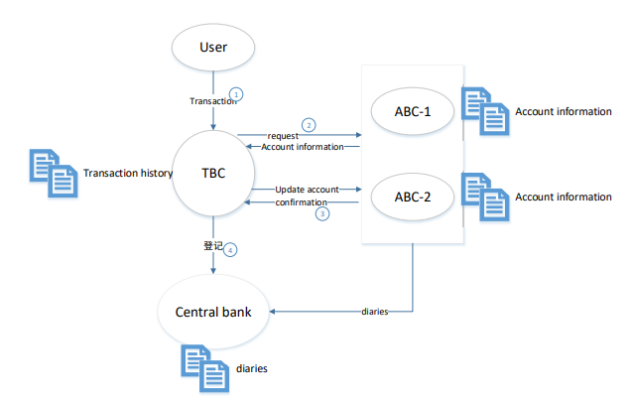
Panda Model
Architecture
Initiate Transaction
Uploading account info
Authentication
Verification
Lock some money
Transaction Execution
Vote for transaction and build block
Audit
Notes:
NDN은 활발하게 사용된다
관련 연구로
V-NDN : 모든 컴퓨팅 디바이스 연결
VANET : 빠른 내용 검색을 위한 routing 알고리즘
CCLF : 위치정보와 content를 NDN forwarding을 위한 routing algorithm에 사용

Slide 7
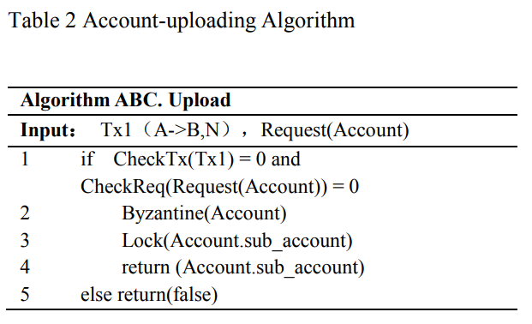
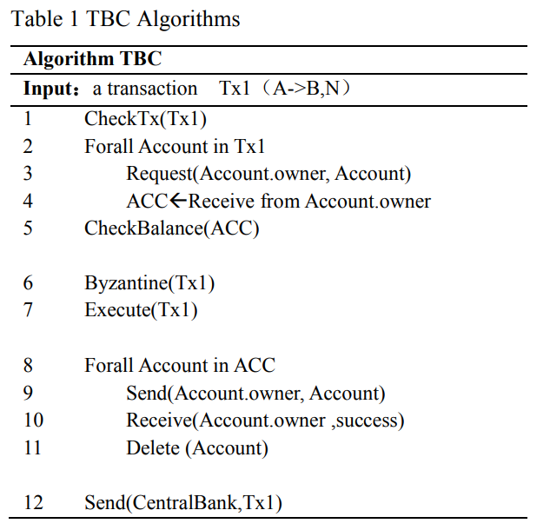
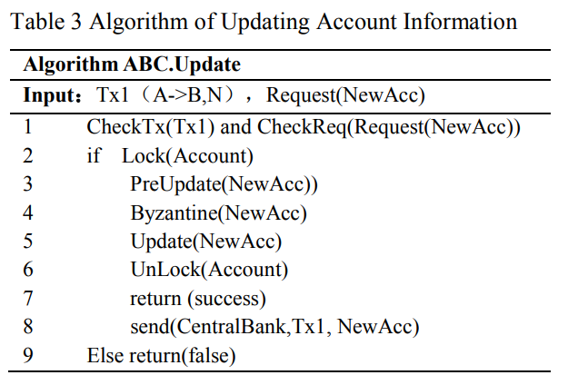
Panda Model
Algorithm
Notes:
NDN은 활발하게 사용된다
관련 연구로
V-NDN : 모든 컴퓨팅 디바이스 연결
VANET : 빠른 내용 검색을 위한 routing 알고리즘
CCLF : 위치정보와 content를 NDN forwarding을 위한 routing algorithm에 사용

Slide 8
Architecture
Features
High throughput and low latency
Transactions are handled locally
Low energy Consumption
Security
Privacy
Monitoring
Reliability
Timeliness

Slide 9
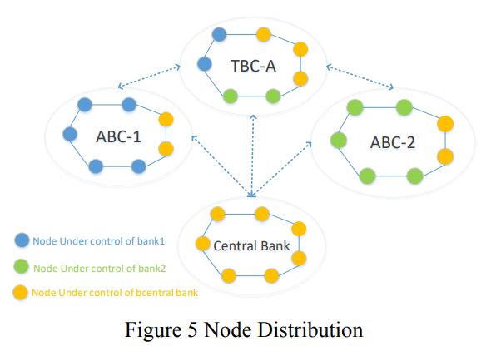
Architecture
Node distribution

Slide 10
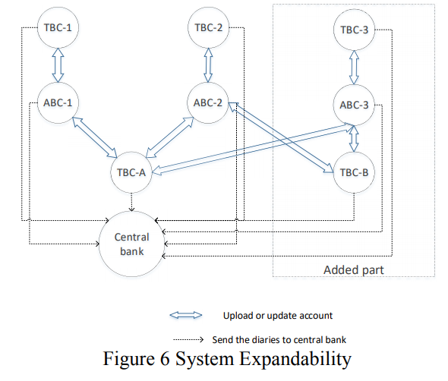
Architecture
Expandability

Slide 11
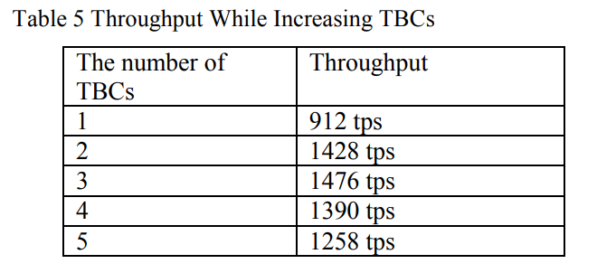
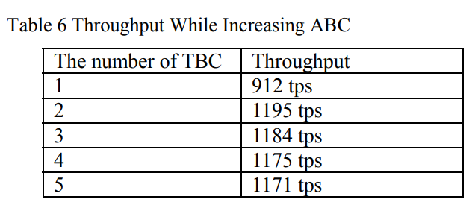
Experiment
LaoShan BC

Slide 12
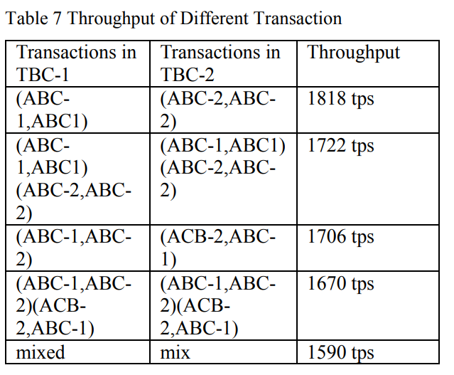
Experiment
LaoShan BC

Slide 13
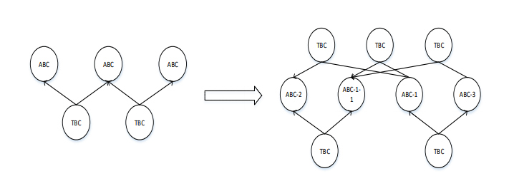
Experiment
Discussion
ABC-1 overhead (transaction with ABC-2, ABC3)
So, Divide ABC-1 to ABC-1-1, ABC-1-2
It is Obvious to increase TPS

Slide 14
Conclusion
Panda Model
ABC and TBC
CBDC system can be scaled up with Many BC needed in the system
Fit in current bank system
Central Bank – Commercial Bank

Slide 15
Multi-Blockchain Model for Central Bank Digital Currency
-paper review (8page)-
He Sun¹ Hongliang MAO² , Xiaomin Bai¹, Zhidong Chen¹, Kai Hu1 Wei Yu¹
1 (State Key Laboratory of Software Development Environment, Beihang University) 2 (National Computer Network Emergency Response Technical Team/Coordination Center of China(CNCERT/CC))
2017 18th International Conference on Parallel and Distributed Computing, Applications and Technologies (PDCAT)
Citation : 19
한정수

Slide 16
Introduction
Blockchain CBDC
Temper-resistant
Traceability
De-centrality
Contribution
CBDC model based on Multi-blockchain technology
Protocol for the communication of cross-blockchain for scalability
Analyze scalability, privacy, safety and communication traffic

Slide 17
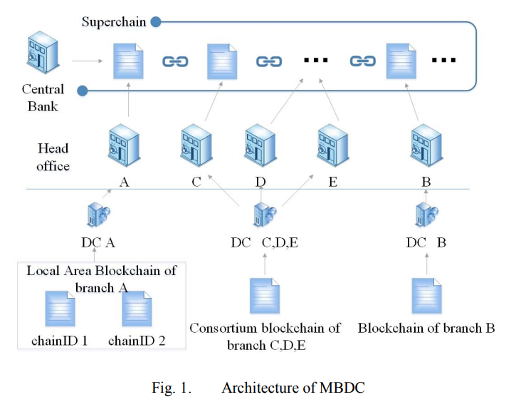
Architecture
MBCD

Slide 18
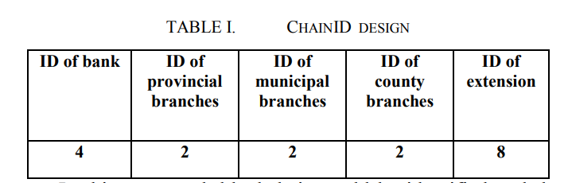
Architecture
Type of Blockchain
Local Area Blockchain (LAB)
Chain ID
ID for LAB
User account address
Every branch create their own public/private key and wallet

Slide 19
Architecutre
Transaction format
Intra-transaction (Tu)
Generated within one branch
Inter-transaction (Tb)
Executed between branches
Feedback-transaction(Tf)
Reply of inter/intra transaction
Timeout-retransmission
Timeout for no reply

Slide 20
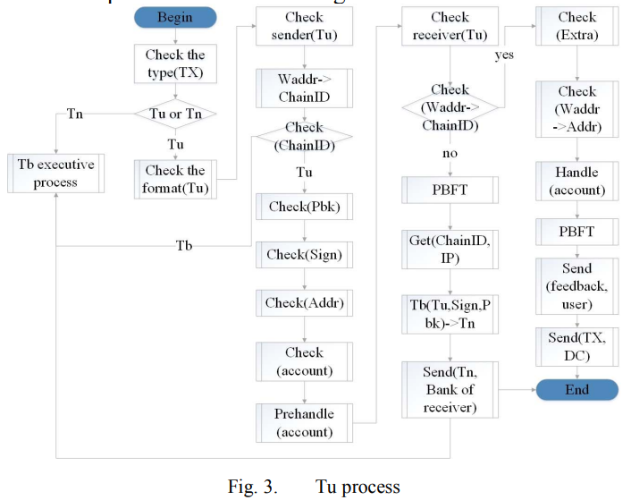
Transaction Protocol
Intra transaction process

Slide 21
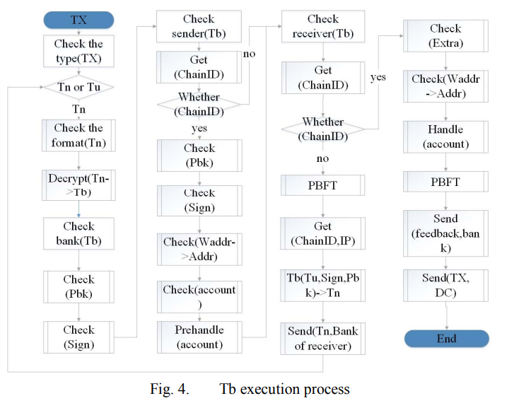
Transaction Protocol
Intra transaction process

Slide 22
Transaction Protocol
Tf Protocol
Success -> branch takes PBFT consensus
Failure -> lock transaction value
Bank reserve Protocol
To reduce inter transaction
Build account for bank in branch

Slide 23
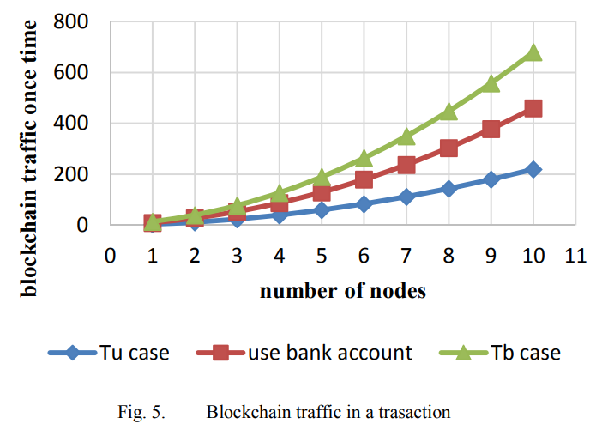
Model analysis
Traffic

Slide 24

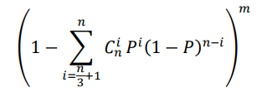
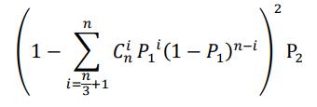
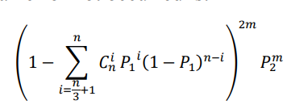
Model analysis
Safety
Intra transaction
Inter transaction

Slide 25
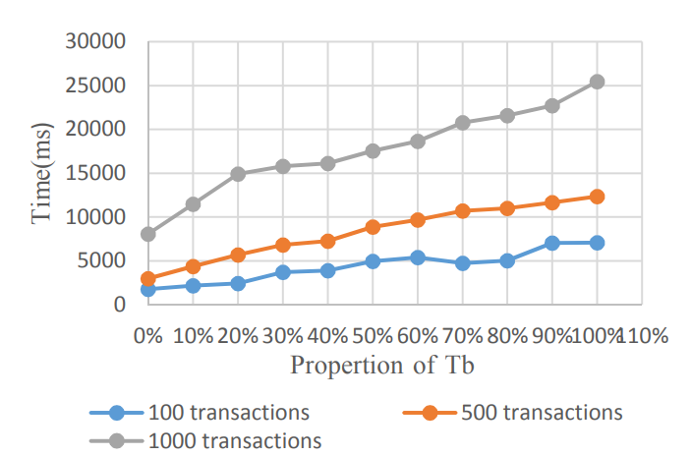
Experiment
Intra/Inter transaction

Slide 26
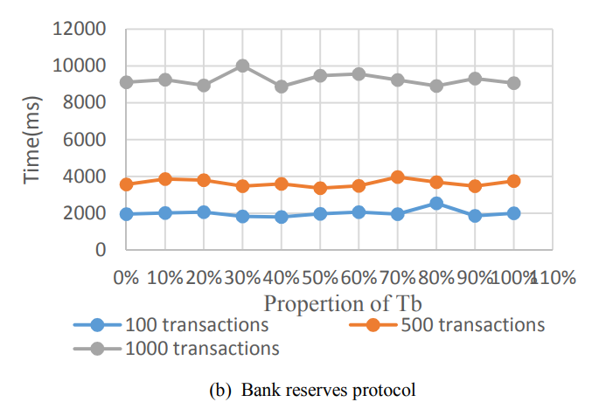
Model analysis
Traffic

Slide 27
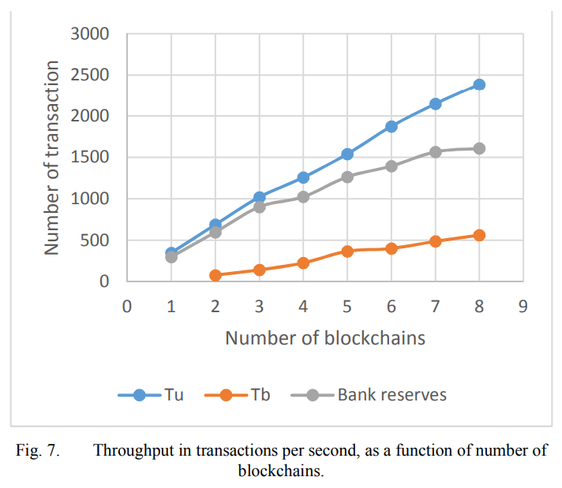
Model analysis
TPS

Slide 28
Conclusion
MBCD
Proposed communication protocol and components
Problems to be solved
Parallel technology for execution of transaction
Establishment of block
Consensus protocol for TPS
Node cluster

Slide 29

Q & A

